Slide 1
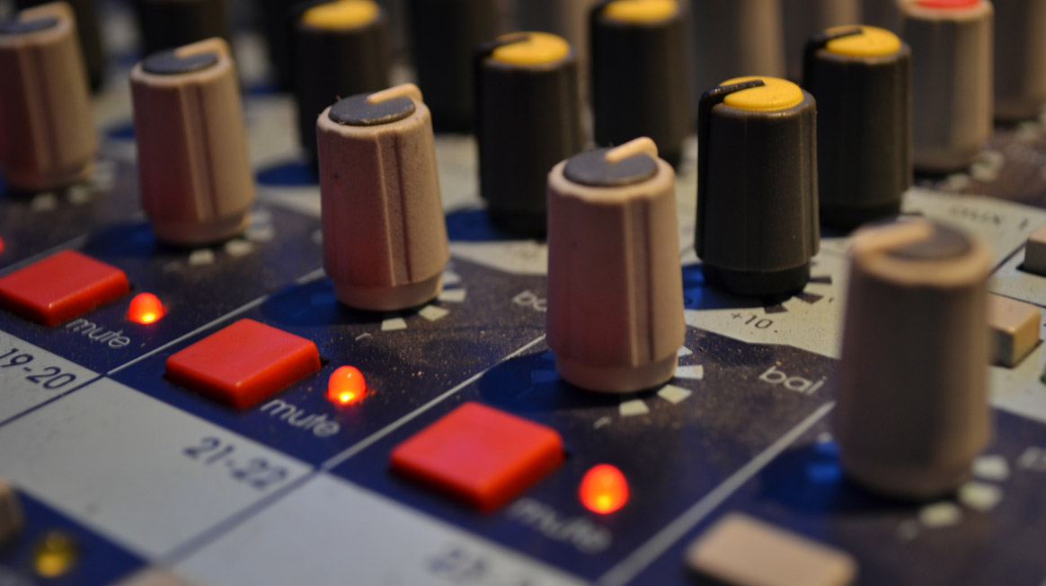
Sound for Game Design Week 5
October 4th 2018
I write most of my songs when I'm in a bad mood.
- Trent Reznor
DMED1490
Mark C. Shannelly
mshannelly@conestogac.on.ca
Notes:
Open the Discussion page!

Slide 2
Today
What is Mood?
Using Mood effectively
How DOOM (2016) uses Mood effectively (video)
Creating an Audio Design Document
Elements of an ADD
Review of a Sample ADD
Assignment #1 Due!!!

Slide 3
What is Mood?
Music is hard to define.
Genres have grown into the thousands
Is ambience music?
Different genres of music bring different moods
Heavy metal doesn’t have lyrics about candy and unicorns (usually)

Slide 4
What is Mood?
Tempo = energy
Musical key and lyrical content = associated feeling.
Volume indicates anger
Mood can influence music, and music can influence mood.

Slide 5
Mood in Games
Used to illustrate many elements of the game:
Genre
What’s happening on screen
Tension, action, dialogue, etc.
Use of SFX

Slide 6
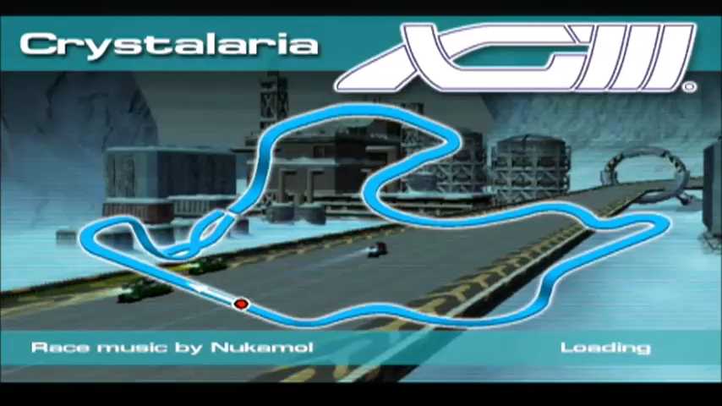
Example

Slide 7

How DOOM uses mood effectively
3D/HD remake of 1993 shooter
Often called one of the first FPS
Extremely violent, even now
MIDI
What does it make you feel?

Slide 8
How DOOM uses mood effectively

Slide 9
Summary
Mood influences entire sound profile of your game
Genre has to fit genre
High energy or high intensity music has to “sit” well
Don’t overthink it

